Slide 1
IF YOU HAD UNLIMITED $$$
HOW MUCH WOULD YOU PAY FOR…

Slide 2
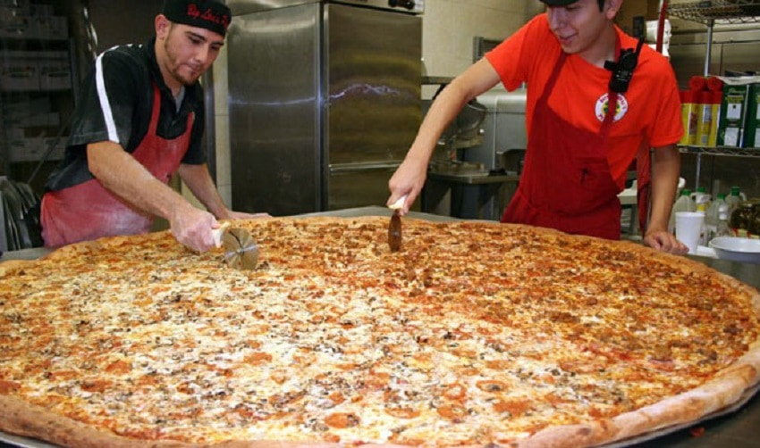
A GIANT PIZZA

Slide 3
A CUTE PUPPY

Slide 4
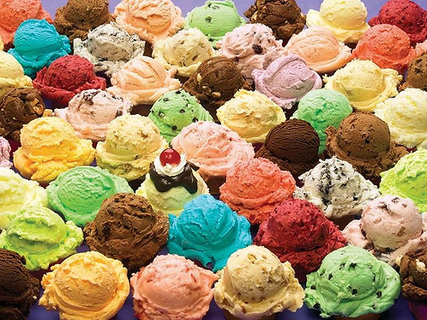
UNLIMITED ICE-CREAM FOR LIFE

Slide 5
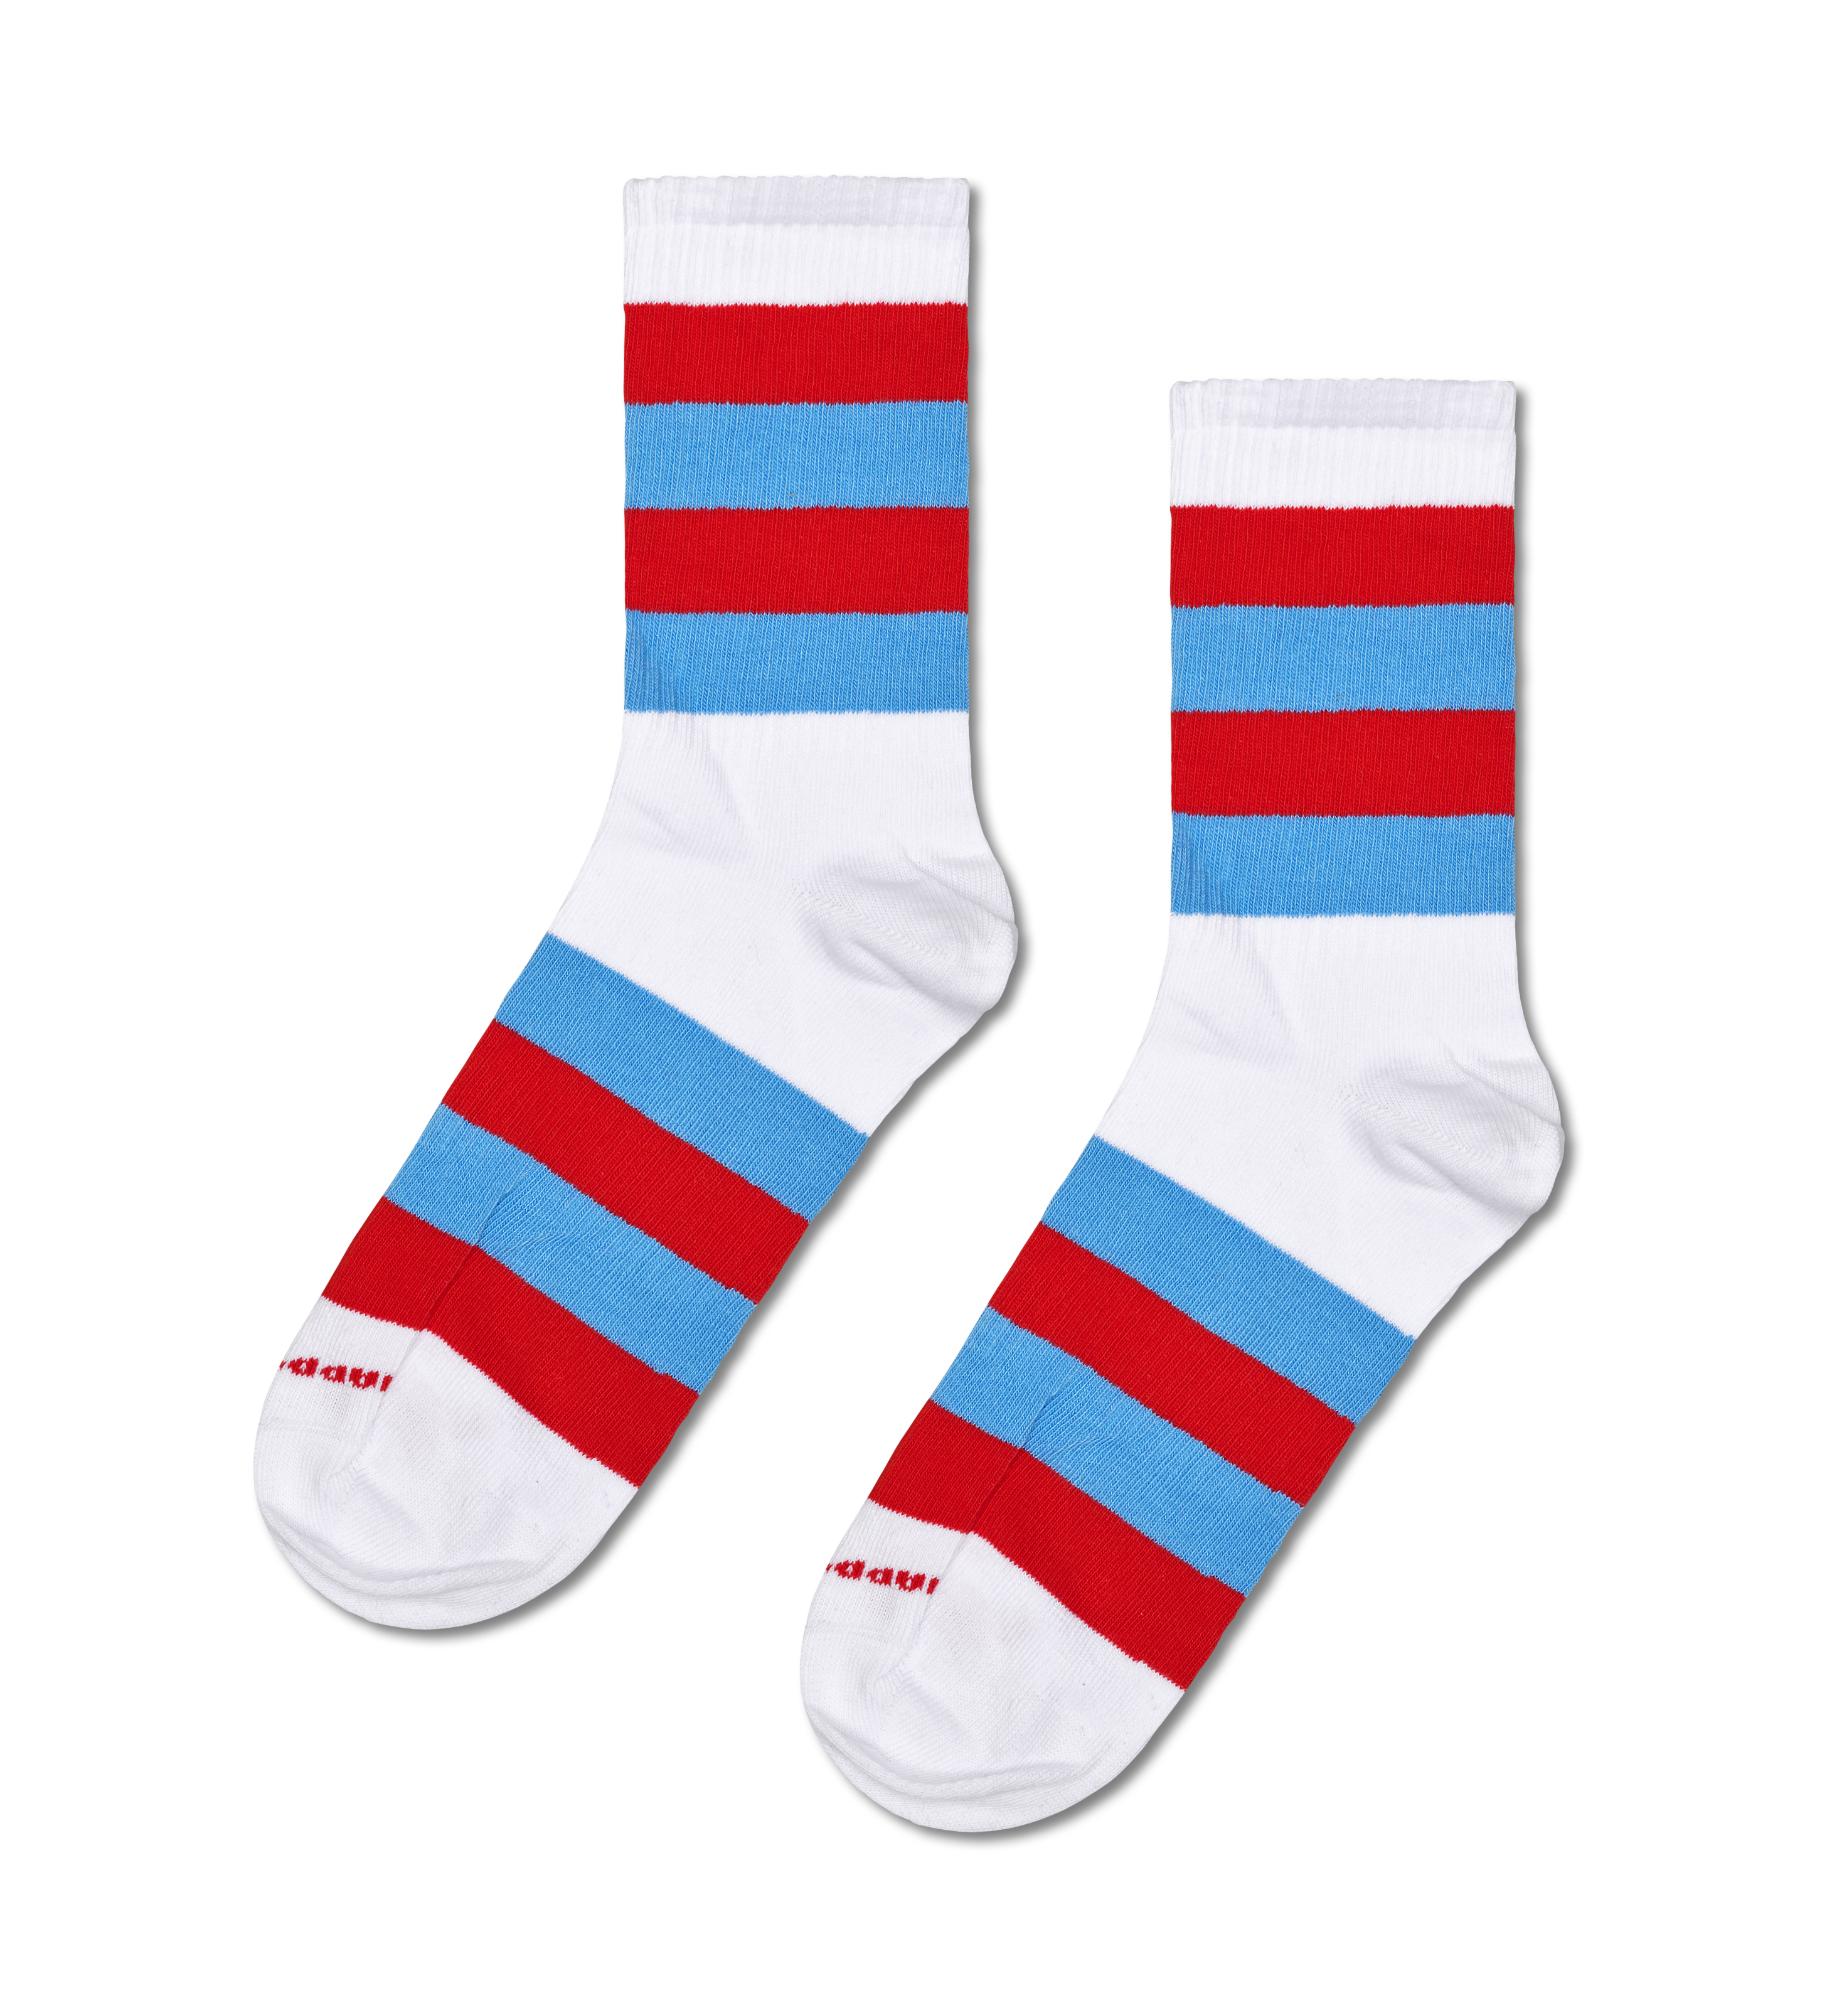
A PAIR OF SOCKS

Slide 6
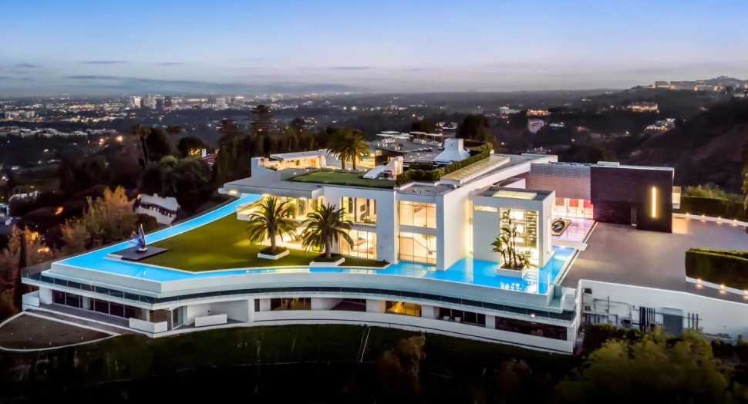
A MASSIVE MANSION

Slide 7
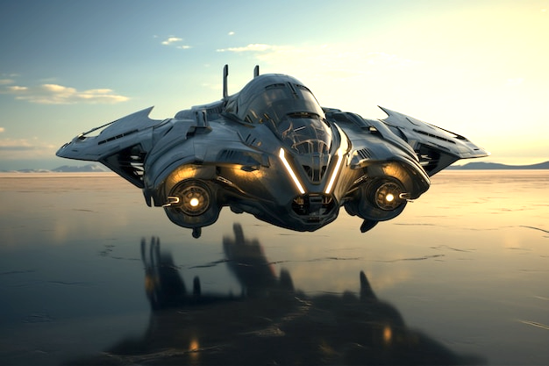
A REAL, WORKING SPACESHIP

Slide 8
ETERNAL LIFE

