Slide 1
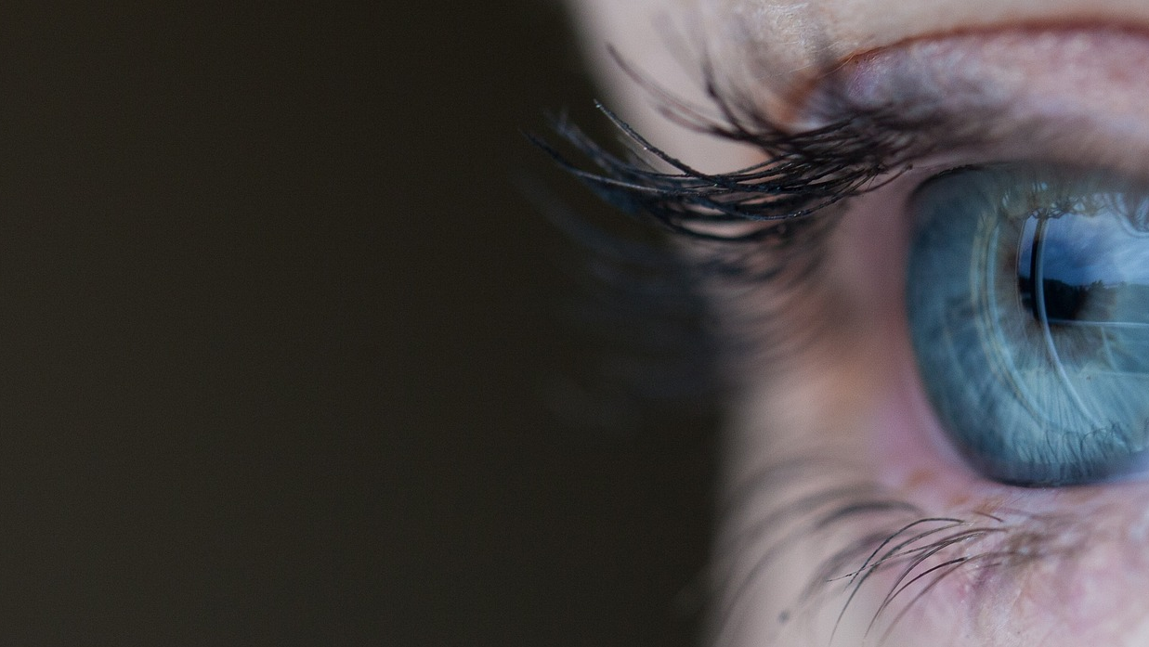
More than Meets the Eye

Slide 2
ACTIVITY #1
What can you see in each picture?

Slide 8
