Slide 1
Secret Sound

Slide 2
Click ’right’ to hear the next sound and again for the answer
Click ‘left’ to go back at any time

Slide 3
Sound #1

Slide 5
Sound #2

Slide 6
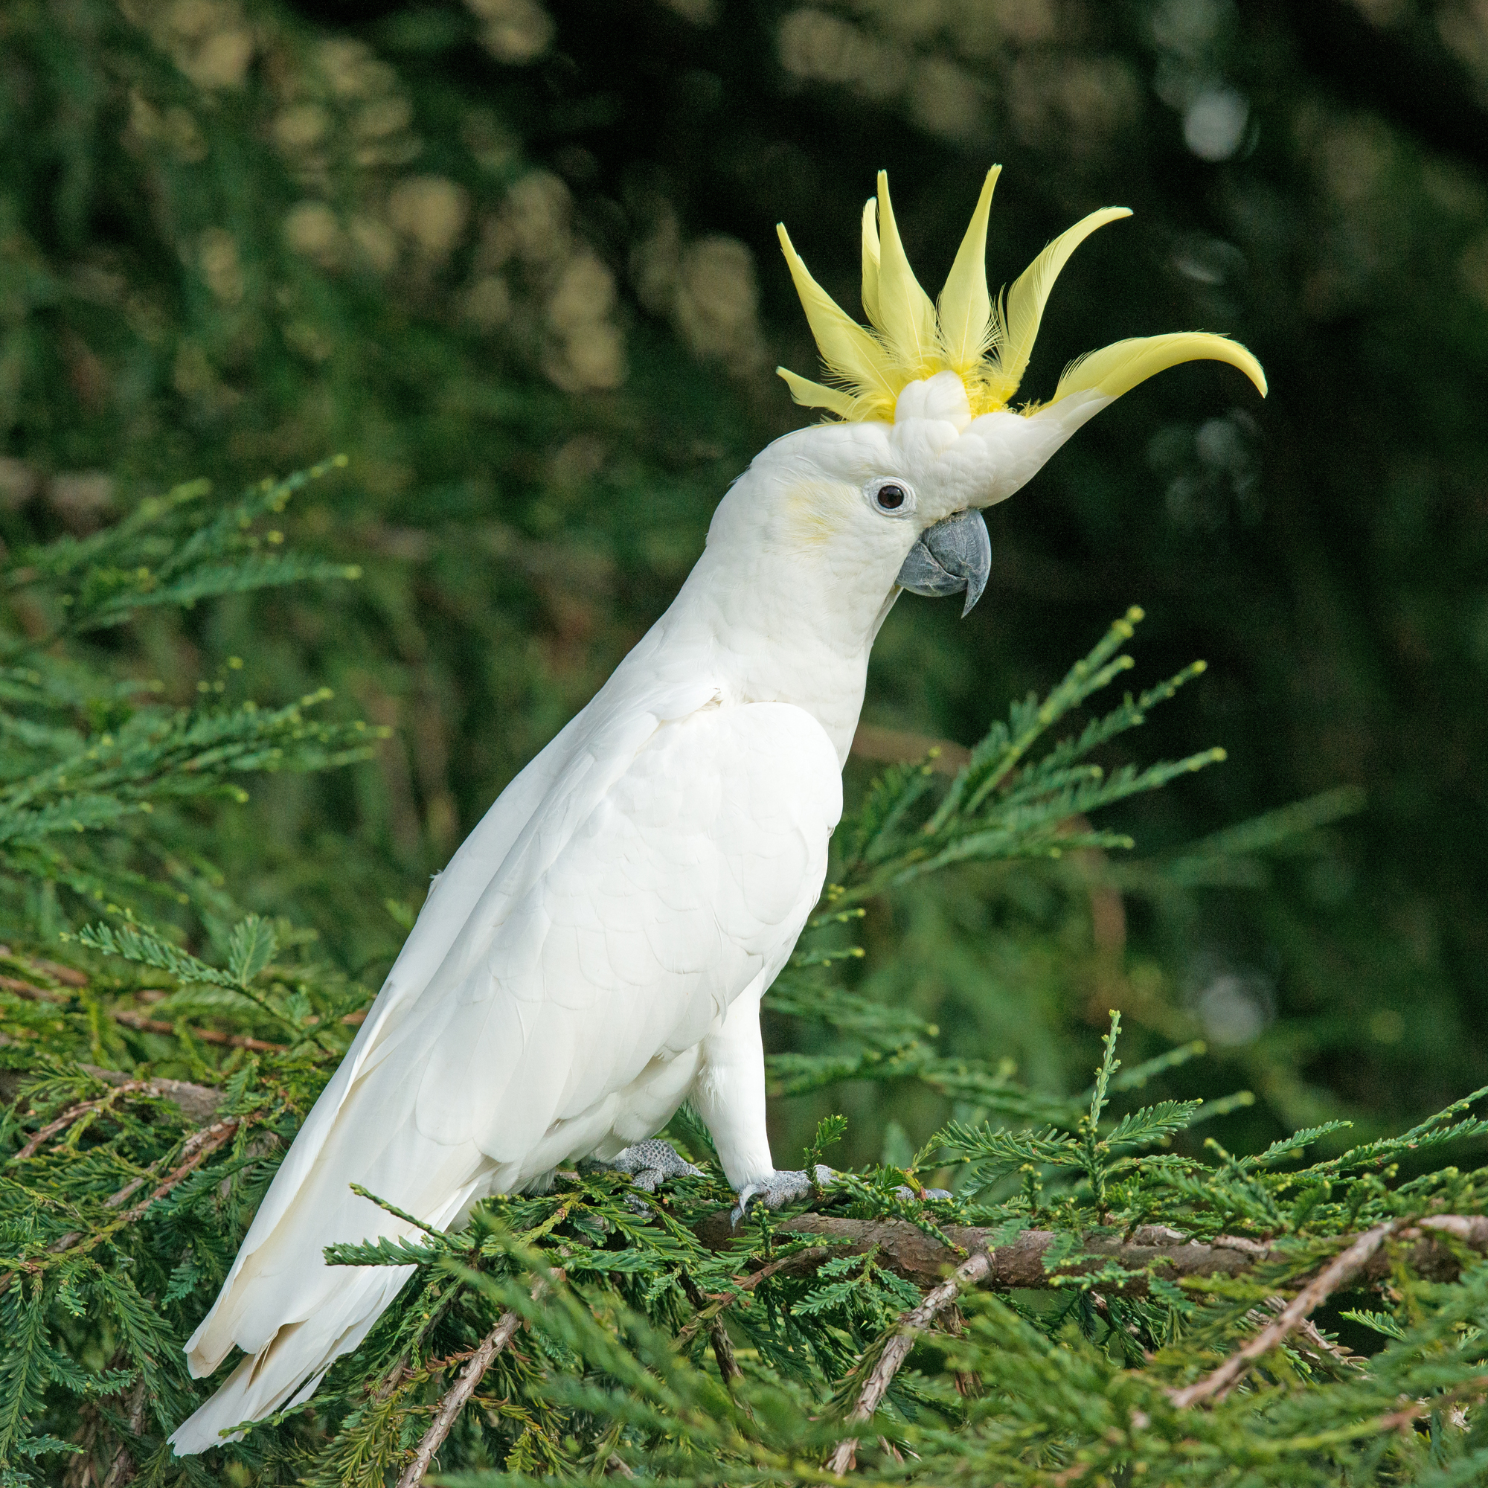
Cockatoo
Sound #2

Slide 7
Sound #3

Slide 8
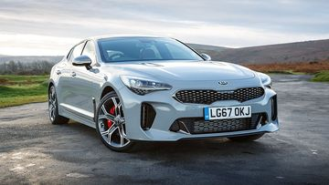
Car Starting
Sound #3

Slide 9
Sound #4

Slide 10
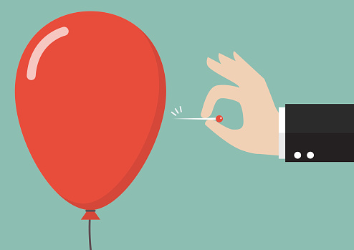
Balloon Pop
Sound #4

Slide 11
Sound #5

Slide 12
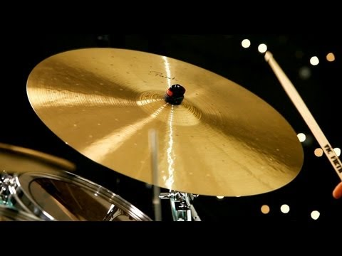
Drum Cymbal
Sound #5

Slide 13
Sound #6

Slide 14
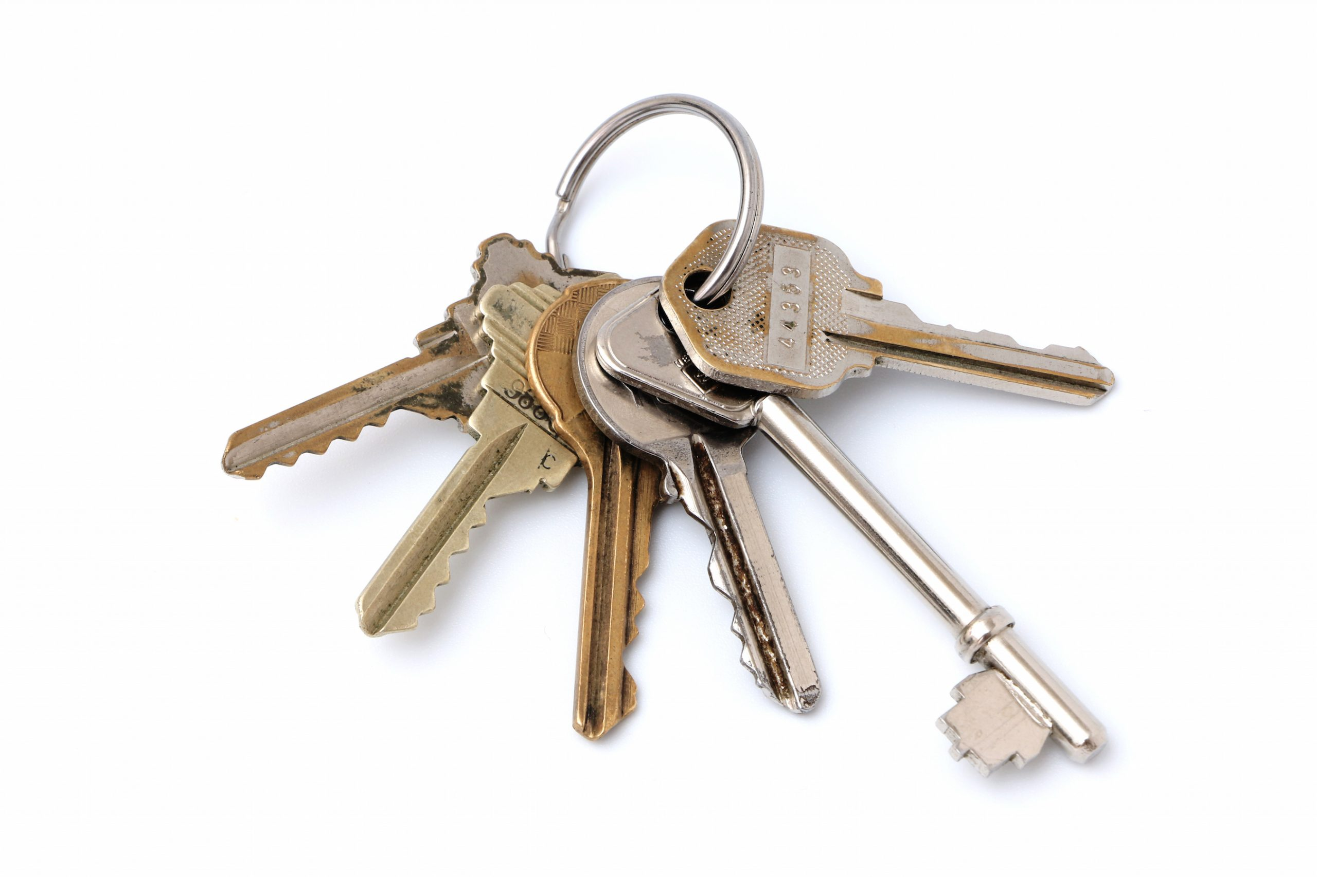
Keys Jingling
Sound #6

Slide 15
Sound #7

Slide 16
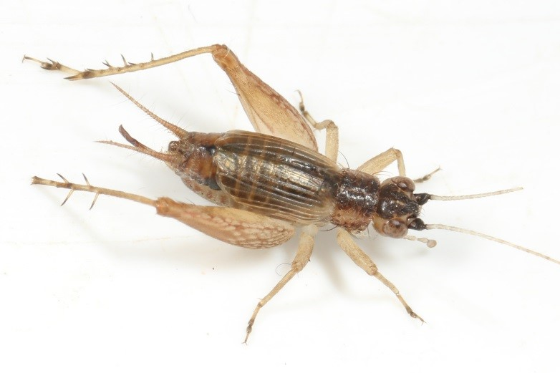
Sound #7
Cricket

Slide 17
Sound #8

Slide 18
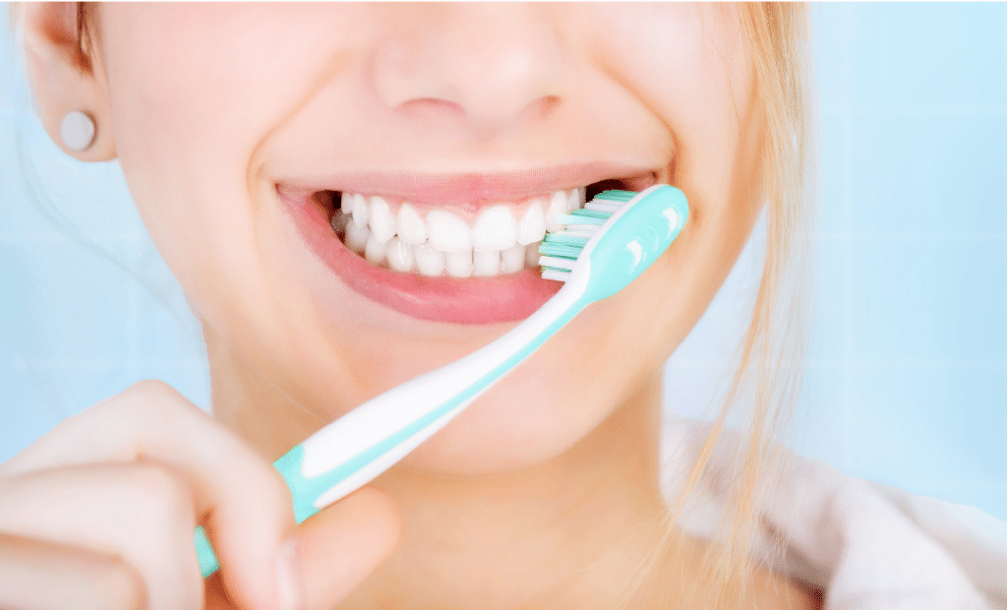
Sound #8
Teeth Brushing

Slide 19
Sound #9

Slide 20
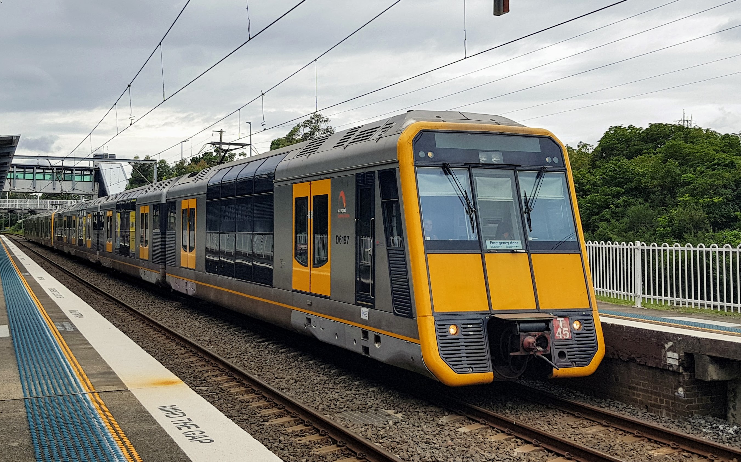
Sound #9
Train

Slide 21
Sound #10

Slide 22
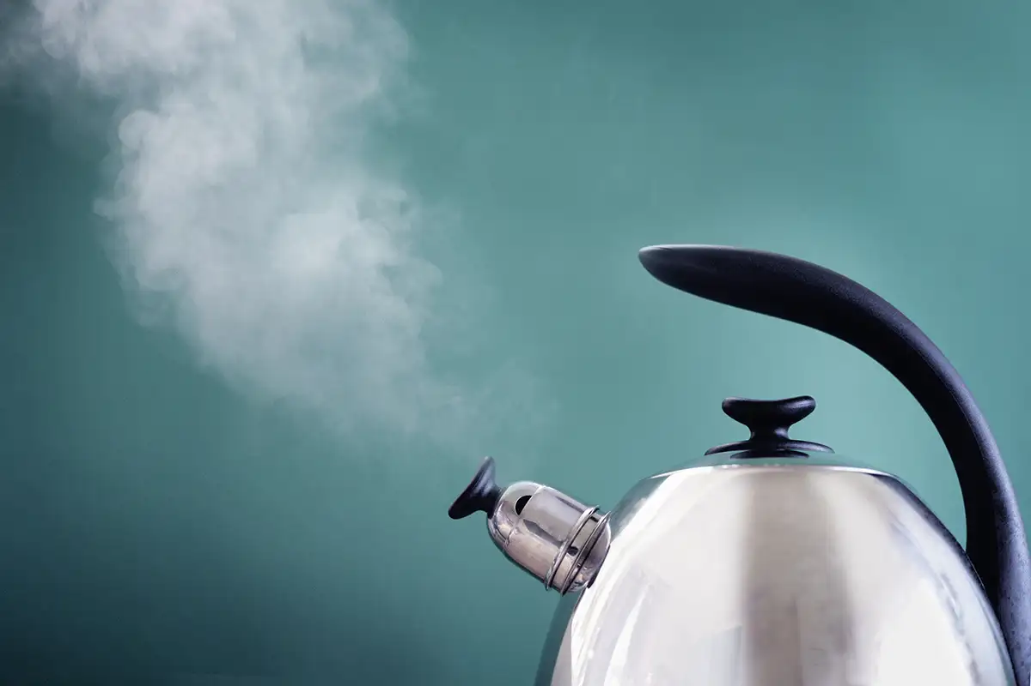
Sound #10
Kettle Whistling

