Slide 1
SPOT THE DIFFERENCE

Slide 2
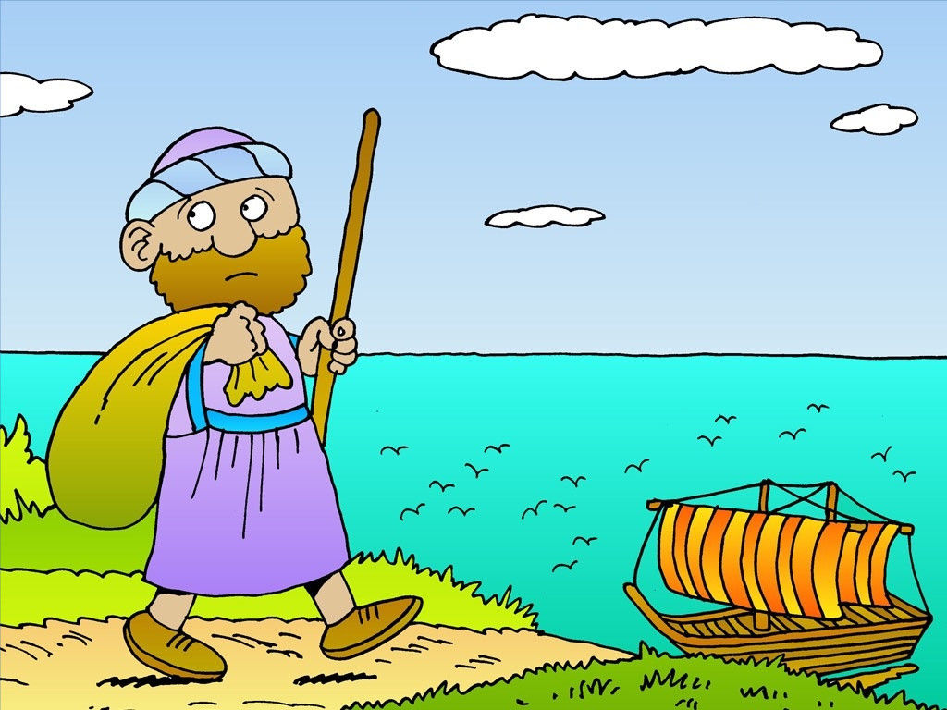
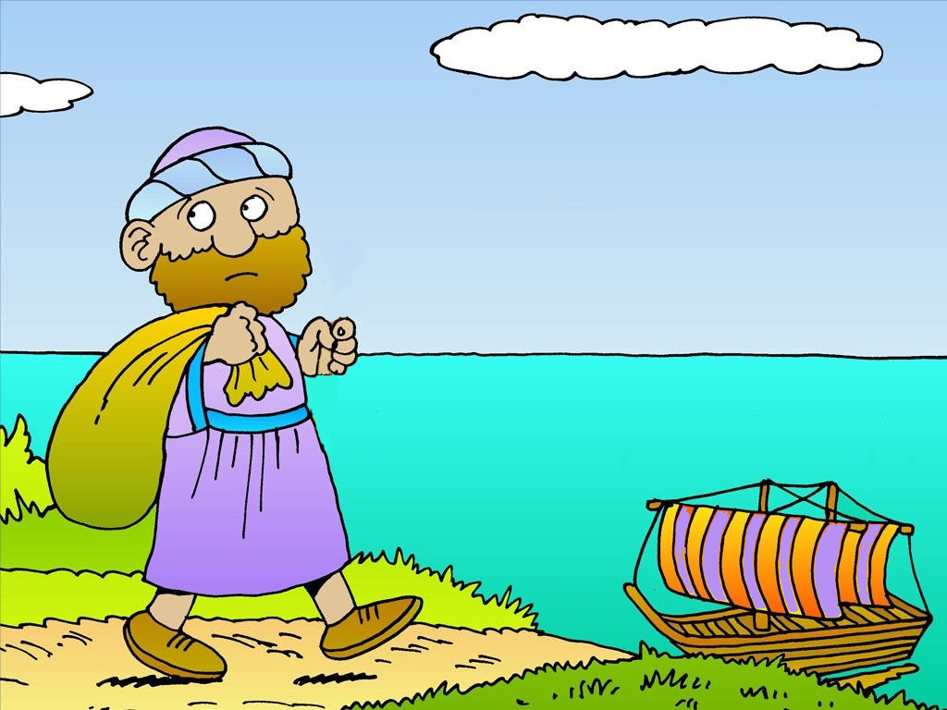
JONAH GETS ON A BOAT
FIND FIVE DIFFERENCES

Slide 3
JONAH GETS ON A BOAT
FIND FIVE DIFFERENCES

Slide 4
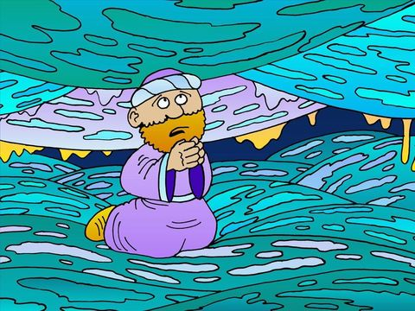
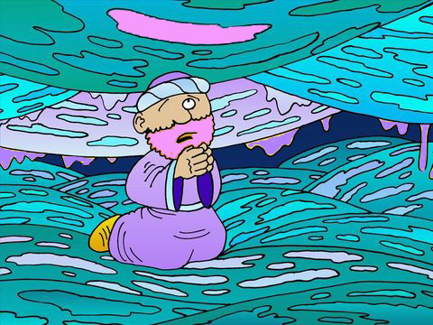
JONAH IN THE FISH
FIND FOUR DIFFERENCES

Slide 5
JONAH IN THE FISH
FIND FOUR DIFFERENCES

Slide 6
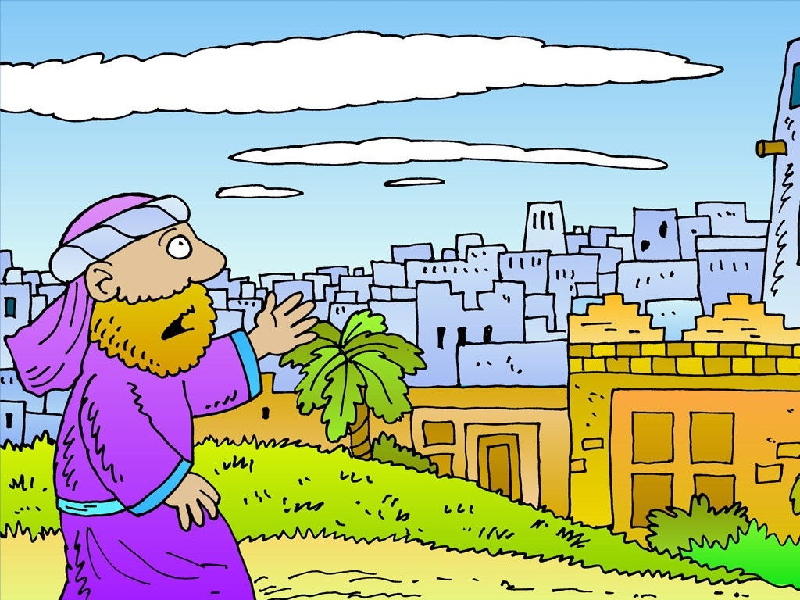
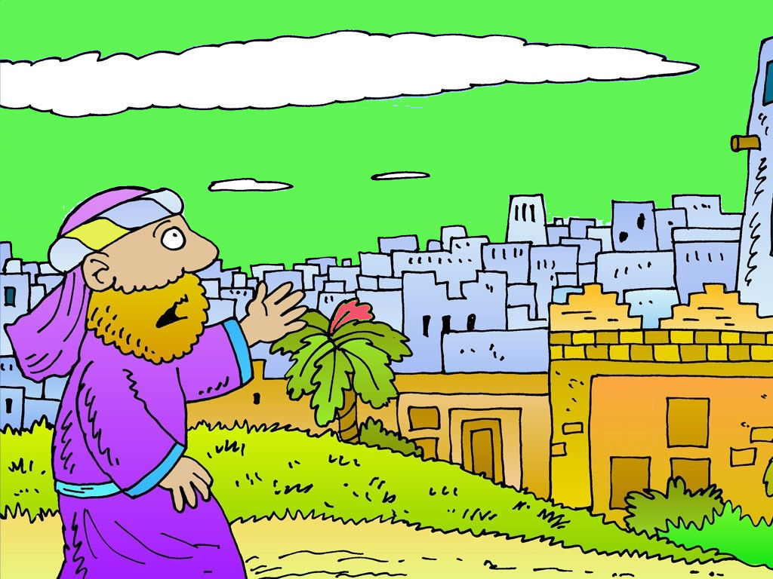
JONAH GETS TO NINEVEH
FIND FOUR DIFFERENCES

Slide 7
JONAH GETS TO NINEVEH
FIND FOUR DIFFERENCES

Slide 8
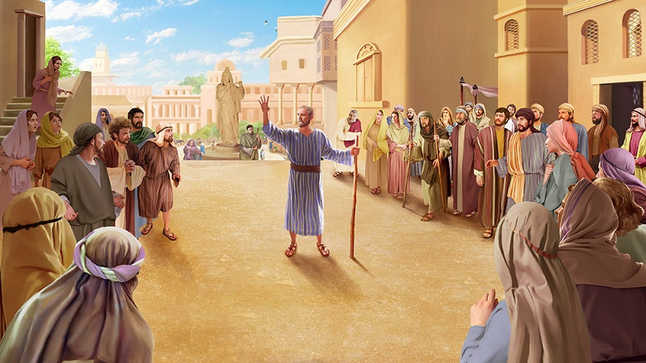
JONAH SPEAKS TO NINEVEH
FIND FIVE DIFFERENCES

Slide 9
JONAH SPEAKS TO NINEVEH
FIND FIVE DIFFERENCES

Slide 10
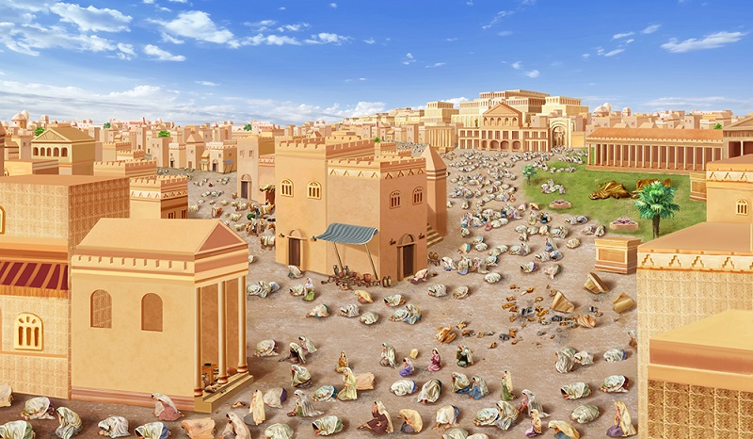
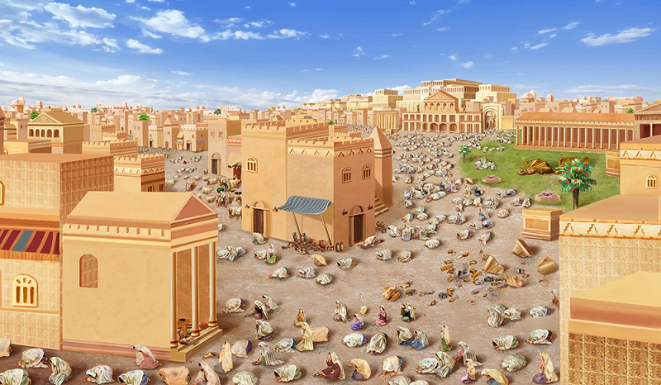
NIneveh Repents
FIND FOUR DIFFERENCES

Slide 11
NIneveh Repents
FIND FOUR DIFFERENCES

